Slide 1

CONTROL SYSTEMS PROJECT (UE21EC241B) THRUST VECTOR CONTROL (TVC)
Sumukh S , PES1UG21EC302
Sumanth R, PES1UG21EC301
Sujal L , PES1UG21EC300

Slide 2
Aim of the project
To design a PID controller system to control the relationship between thrust angle and nozzle angle.
The aim of missile control system which is being designed is to protect the relationship between nozzle angle and thrust angle on ballistic missiles.

Slide 3
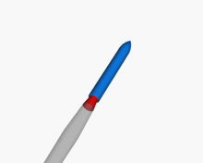
What is TVC?
Thrust vector control (TVC), also known as thrust vectoring, is the ability of an aircraft, rocket, or other vehicle to manipulate the direction of the thrust from its engine or motor to control the angular velocity of the vehicle.

Slide 4
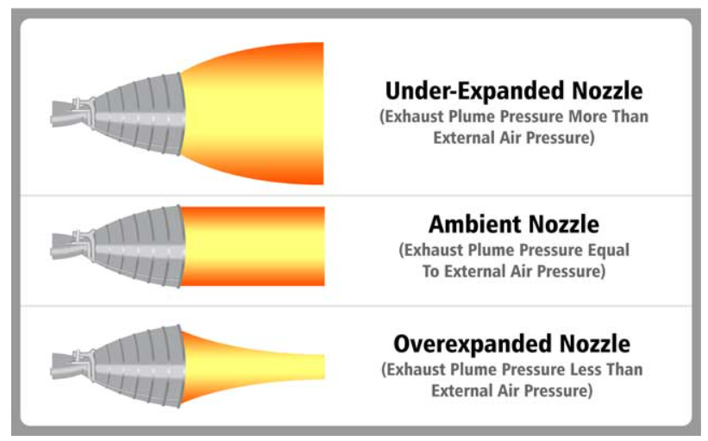
Nozzle Angle
It is the angle between the axis of the rocket nozzle and the axis of the rocket engine. It is also known as the divergence angle or the nozzle divergence angle.
How nozzle angle affects the thrust:

Slide 5
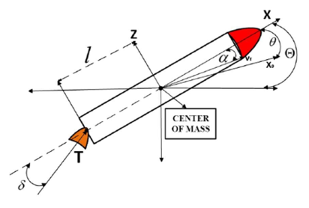

To make the missile to travel in the desired trajectory ,relation between thrust vector and nozzle angle is important.
This relation is given by the following open loop transfer function
G(s)=$\frac{ɵ(s)}{δ(s)}=\frac{−7.21(s+0.0526)}{(s+16)(s−1.48)(s−0.023)}$
Where θ is thrust angle
δ is nozzle angle
Poles are located at -16, +1.48, +0.023
Zero is located at -0.0526

Slide 6
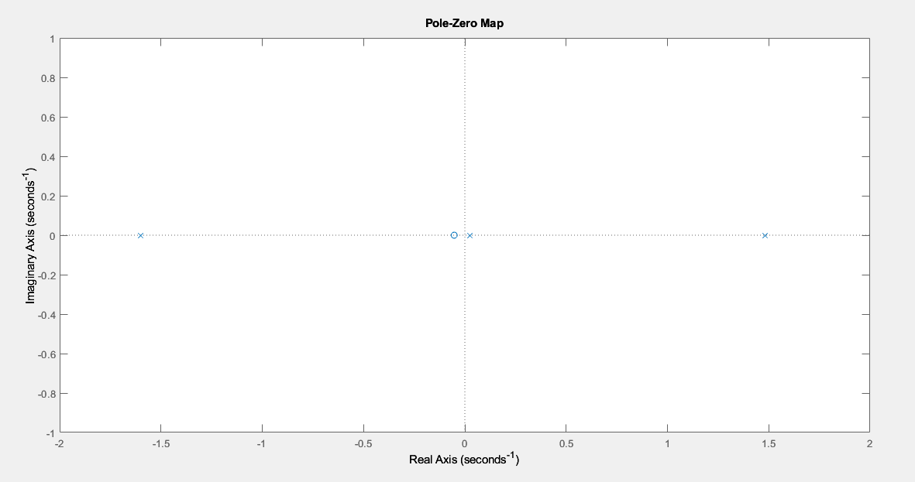
Pole Zero Map of the Open Loop System
As we can seen there are two poles on the right hand plane in the s domain, hence the open loop system is unstable.

Slide 7
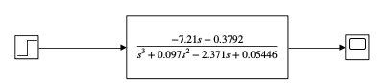
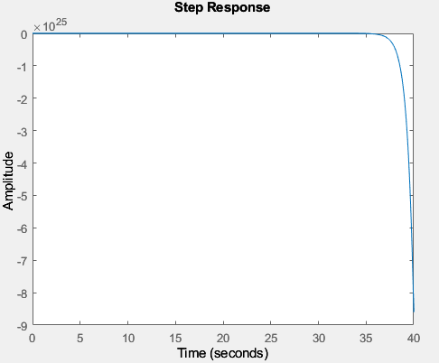
Open loop response for unit step input:

Slide 8
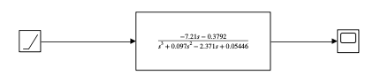
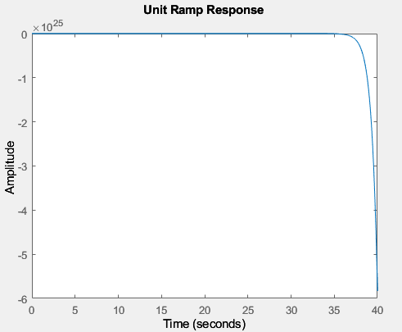
Open loop response for unit ramp input:

Slide 9
Inference
As we can see there is no oscillation, this means there are no complex poles.
Responses are unbounded, as the system is unstable due to RHP poles.

Slide 10
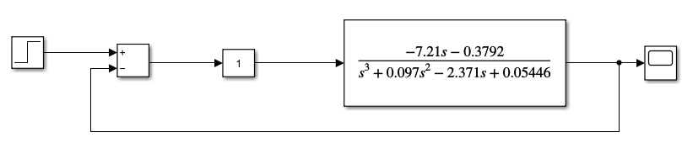
Unity Feedback System
Now let us apply unity feedback to the system with gain ‘K’ kept in cascade to the given system. Initial value of K is 1.

Slide 11
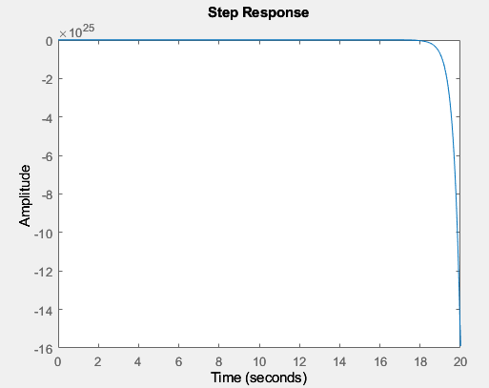
Unit step response of close loop system for k=1
We can see the graph is tending to -infinity which is unbonded. Hence we can say the closed loop system is unstable.

Slide 12
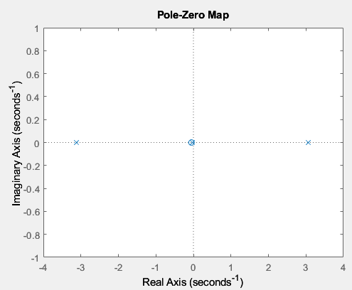
Pole Zero map
We infer that the one pole is on right hand plane, the system is unstable.

Slide 13
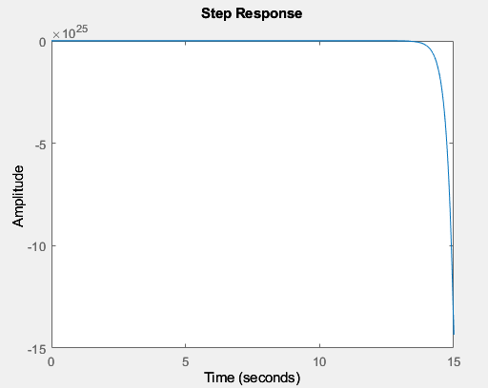

K=2
K=3

Slide 14
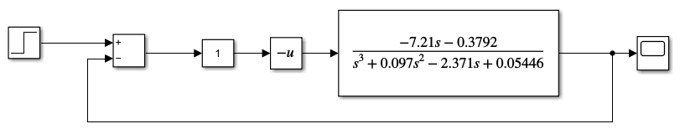
The closed loop system is unstable for all positive values of the gain K.
So we place an inverter in cascade to the gain K to make the system closed loop stable.

Slide 15
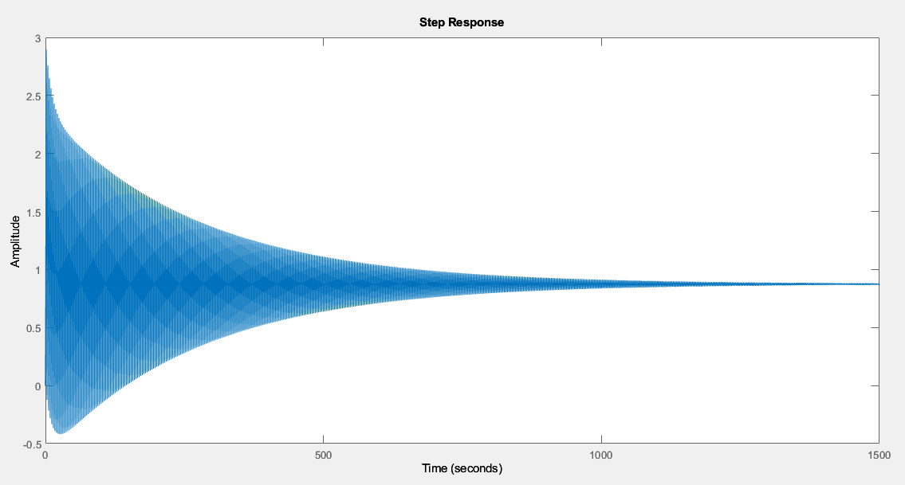
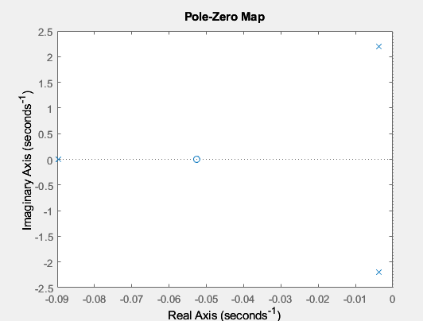
Now lets put k=1
Step response Pole zero map

Slide 16
From the pole zero map, we infer that the system is now closed loop stable with the time domain parameters:
Rise Time: 0.3372s
Settling Time: 1.2068*10³s
Overshoot: 231.2%
Undershoot: 47.9%
Steady state error: -1.8967

Slide 17
To Find the Range of K for stability
The characteristic equation is given by :
1 + (-1)*K*G(s) = 0
s³ + 0.097s² +(-2.371+7.21K)s + (0.054 +0.38K) = 0
Using Routh-Hurwitz Criterion,
The range of K obtained from the Routh array is K > 0.889
The closed loop system is marginally stable at K=0.889.
s³ | 1 | -2.371+7.21K
s² | 0.097 | 0.054+0.38K
s¹ | b1
s⁰ | 0.054+0.38K

Slide 18
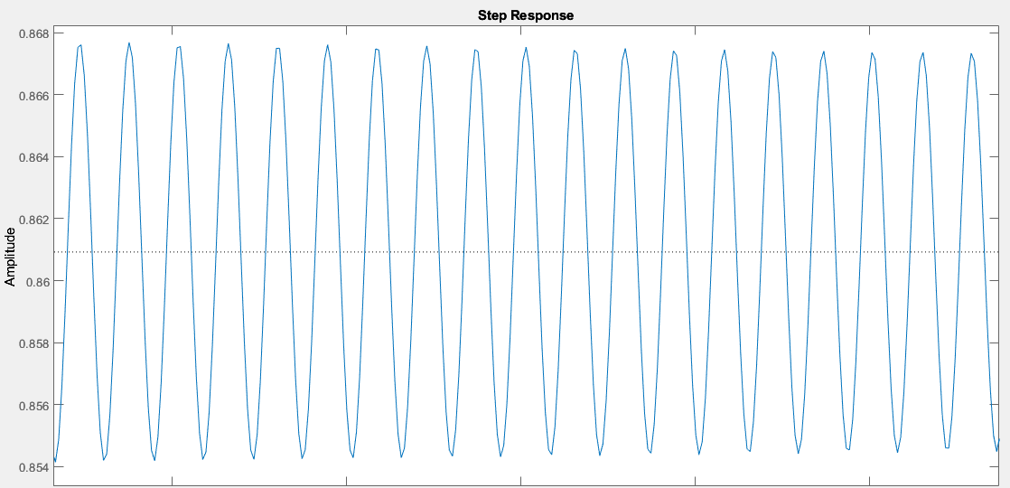
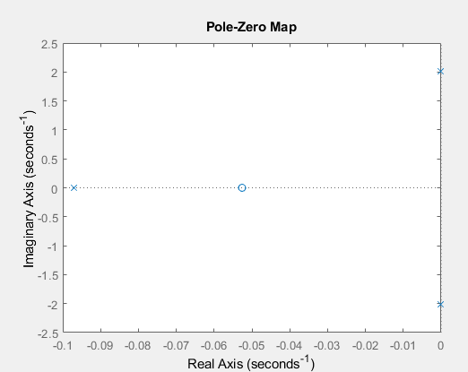
Step response Pole zero map (for K=0.889)
Conjugate poles are present on the jw axis, indicating marginal stability.
Thus the value of K at which the output starts oscillating is K=0.889.
Frequency of oscillations: 2.01 rad/s

Slide 19
Differences In System Behaviour From Open Loop To Closed Loop
The open loop system is unstable. On addition of a unity feedback path, and an inverter cascaded to the gain block K, the system becomes stable for K>0.889.
The unit step response of the open loop system is unbounded.
The unit step response of the closed loop system (with appropriate gain K) is bounded.

Slide 20
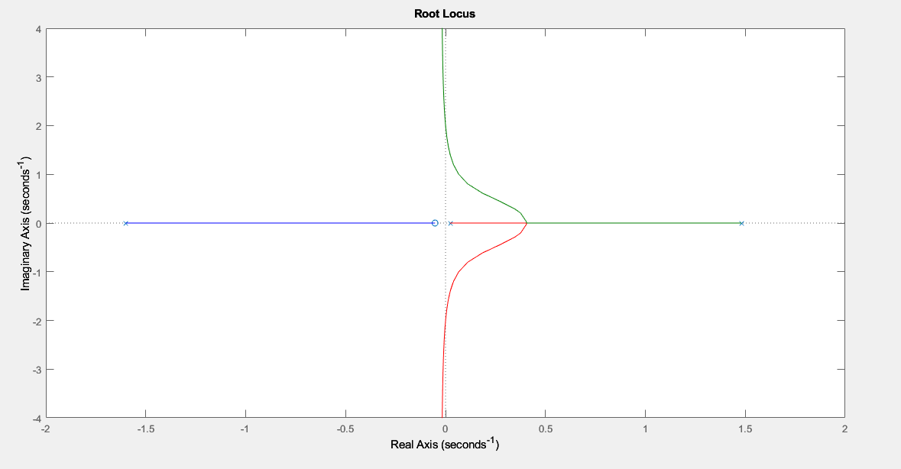
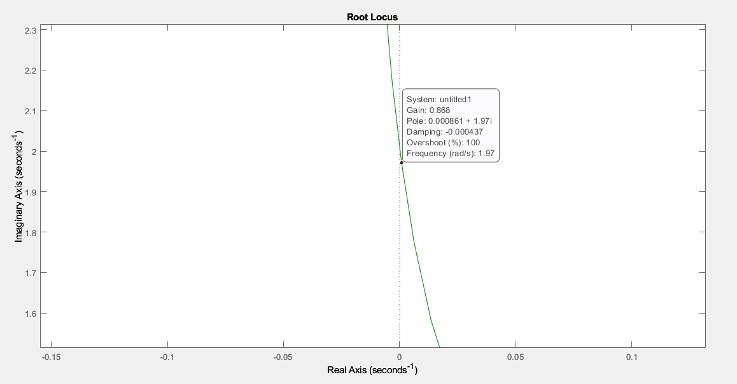
Root Locus
From the graph we can infer that, at the point of crossover of the root locus with the jw axis, the gain is 0.868. Frequency of oscillations is 1.97 rad/s.
Which is almost the same as the analytical values (K=0.889 and 2.01 rad/s)

Slide 21
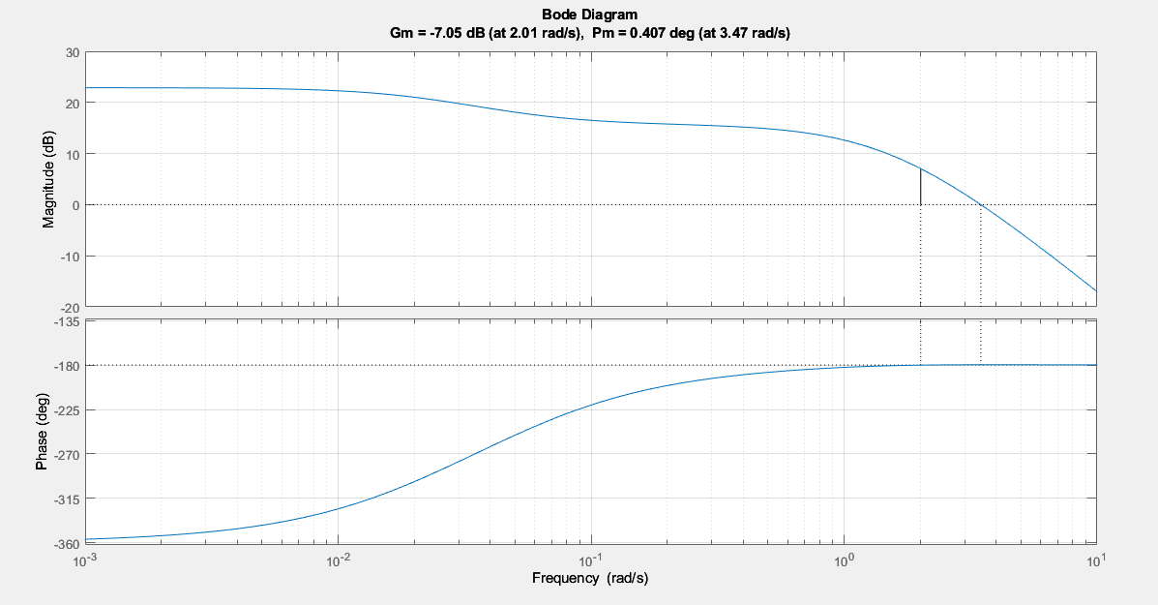
Bode Plot (K=2)
Gain Margin= -7.05 dB, Phase Margin= 0.41 degrees
As we can see phase margin is positive. Hence we can infer the system is closed loop stable.

Slide 22
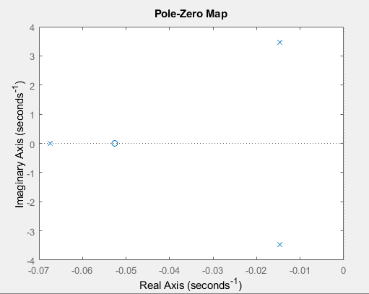
Pole zero map for K=2
The pole zero map of closed loop system supports the inference obtained from bode plot.
We note that the phase margin is very close to zero, hence the system is not very robust.

Slide 23
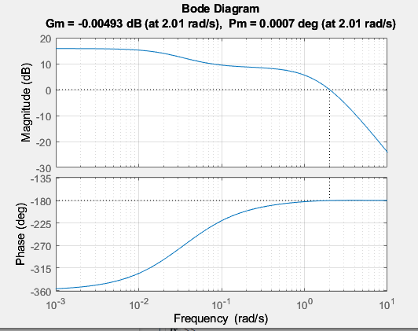
For K=0.889, (Value of K for marginal stability)
Bode plot
The gain crossover frequency is equal to the phase crossover frequency.

Slide 24

Nyquist Plot (K=2)
For close loop system to stable Z must be 0
Z=N+P
Where N is number of clockwise closed loop encirclements of the point (-1,0), and P is number of open loop poles lying in RHP of s-plane
G(s)=$\frac{ɵ(s)}{δ(s)}=\frac{−7.21(s+0.0526)}{(s+16)(s−1.48)(s−0.023)}$
As we can see we have two poles on RHP hence P=2

Slide 25
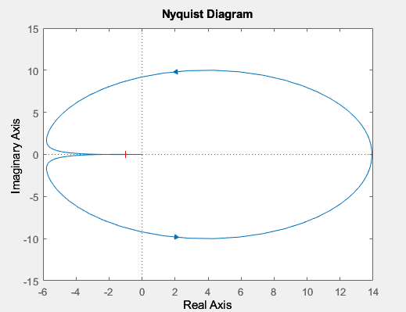
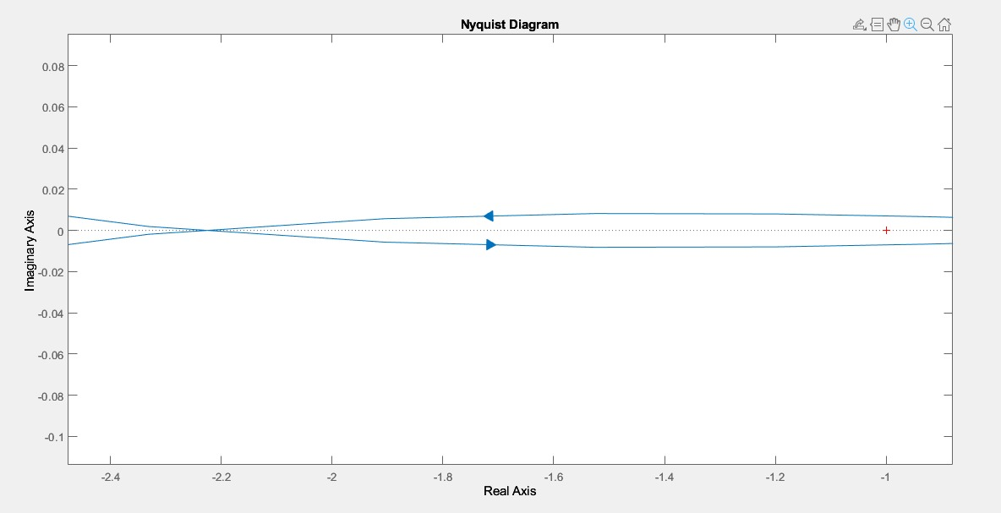
As we can see from the plot , (-1,0) is twice encircled in the anti-clock wise direction, N=-2
Z=N+P=-2+2=0 Hence the system is closed loop stable.

Slide 26
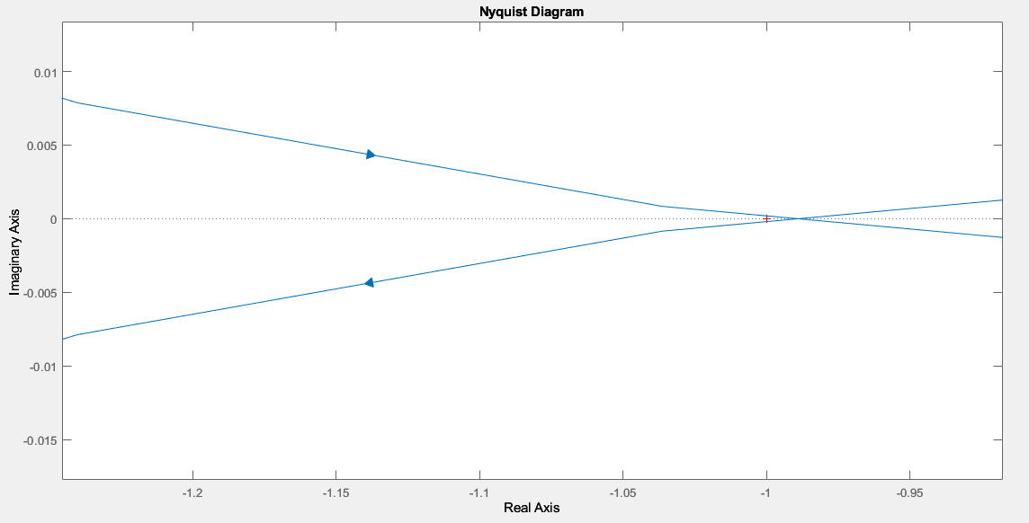
Now For K=0.889
The plot almost touches the -1+j0 point, which verifies that the close loop system is marginally stable.

Slide 27
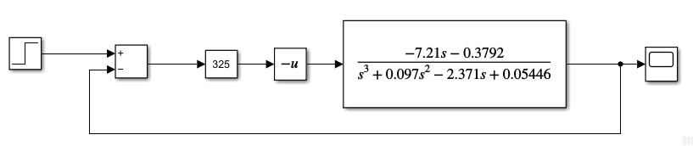
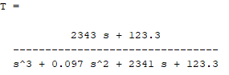
Design Of Controllers
Proportional Controller
Kp is chosen to be 325.
The closed loop transfer function obtained is:

Slide 28
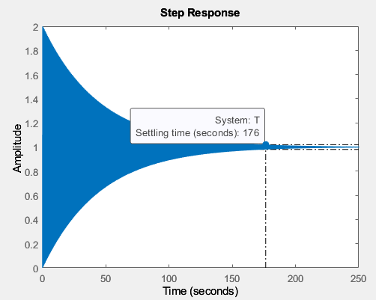
Step response
Settling time = 176 seconds
Peak Overshoot: 99.86%
From overshoot damping coefficient is obtained as 0.0032.
The controller makes the system closed loop stable but the obtained values are very far off the design specifications.

Slide 29
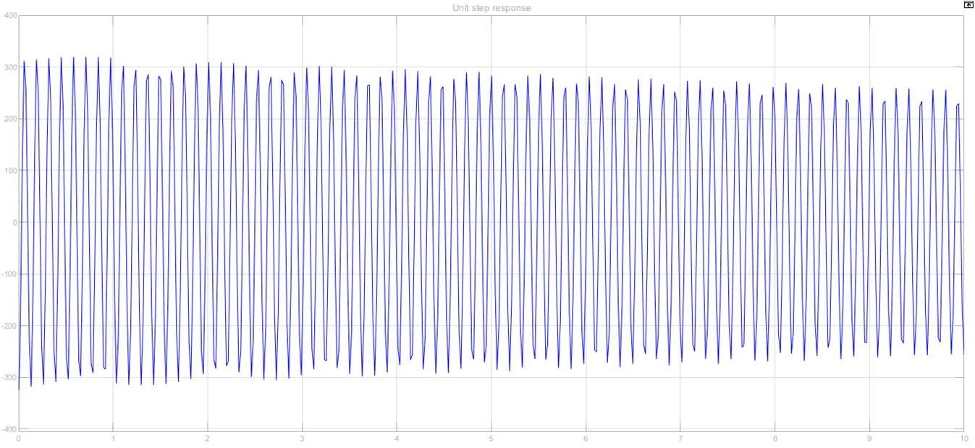
Controller effort

Slide 30
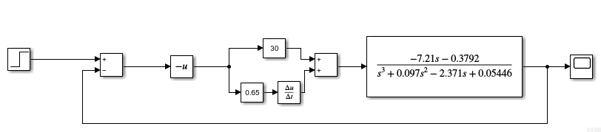
Proportional + Derivative Controller
Case 1: We choose Kp=30, Kd=0.65

Slide 31
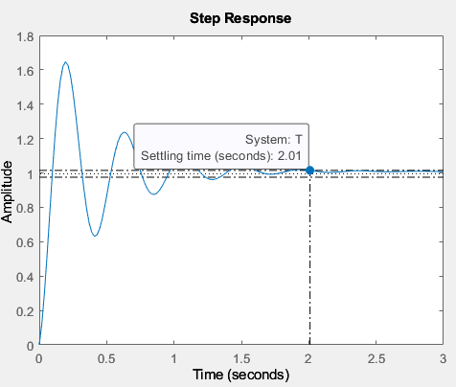
Settling time = 2.01 seconds
Peak Overshoot: 64.47%
From overshoot damping coefficient is obtained as 0.14.
Desired settling time is obtained, but the damping coefficient is very low.

Slide 32
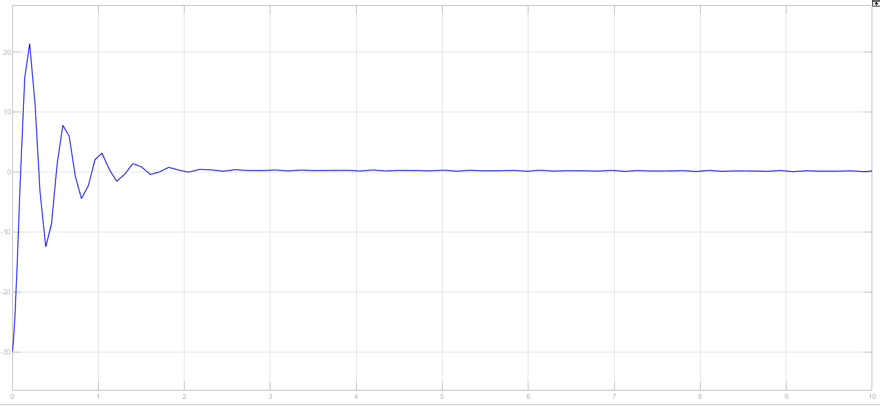
Controller effort

Slide 33
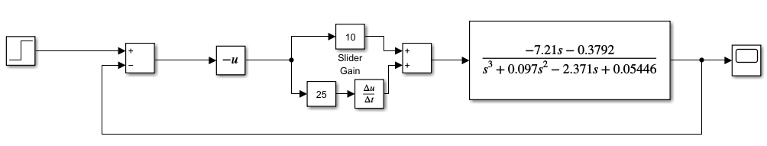
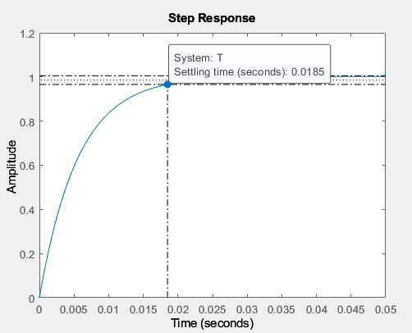
Case 2: We choose Kp=10, Kd=25
Settling time = 0.0185 seconds
Peak Overshoot:1.82%
From overshoot damping coefficient is obtained as 0.79.
Desired damping coefficient is obtained, but the settling time is very low.

Slide 34
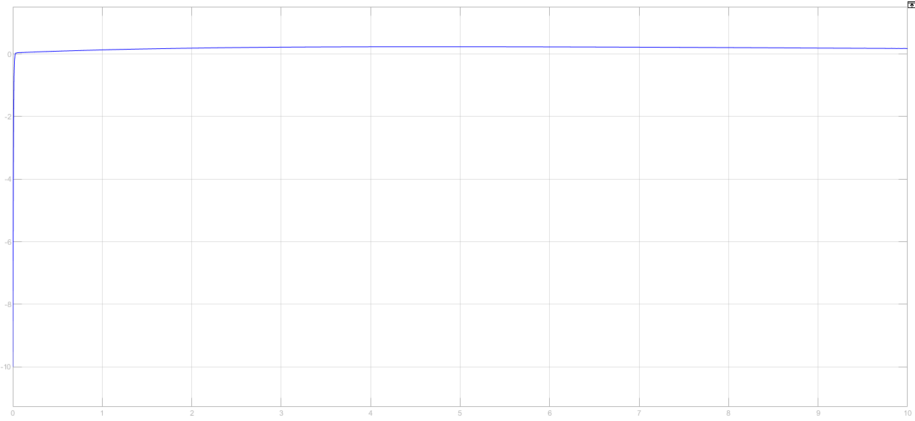
Controller effort
There is a trade-off between settling time and damping coefficient.

Slide 35
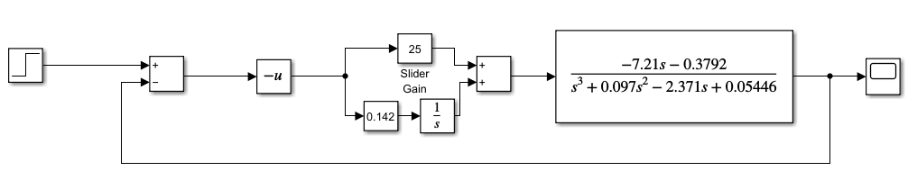
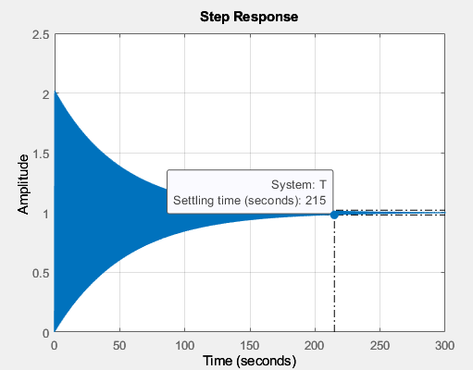
Proportional + Integral Controller
Ki= 0.142, Kp= 25
Settling time = 215 seconds
Peak Overshoot: 99%
From overshoot damping coefficient is obtained as 0.0032.

Slide 36
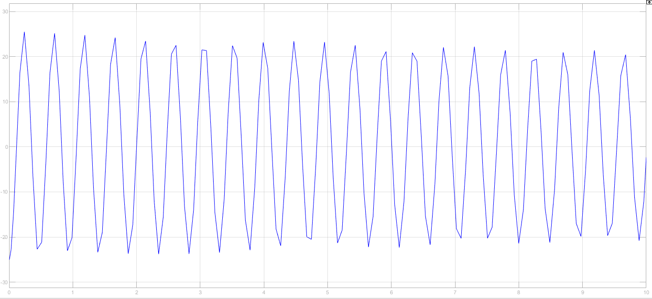
System is closed loop stable but the values are extremely far off the design specifications. If we try to increase Ki, the system becomes unstable. Hence this type of controller is ineffective for our transfer function.
Controller effort

Slide 37
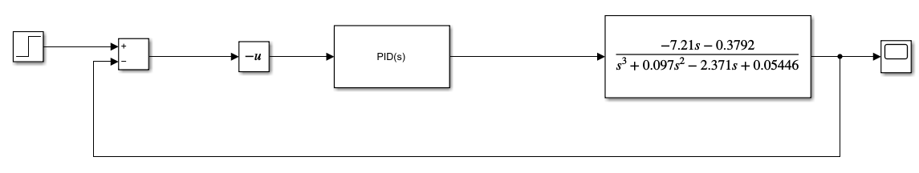
PID controller
We choose the following coefficients,
Kp= 10 ,Kd= 4.9 ,Ki= 4.5

Slide 38
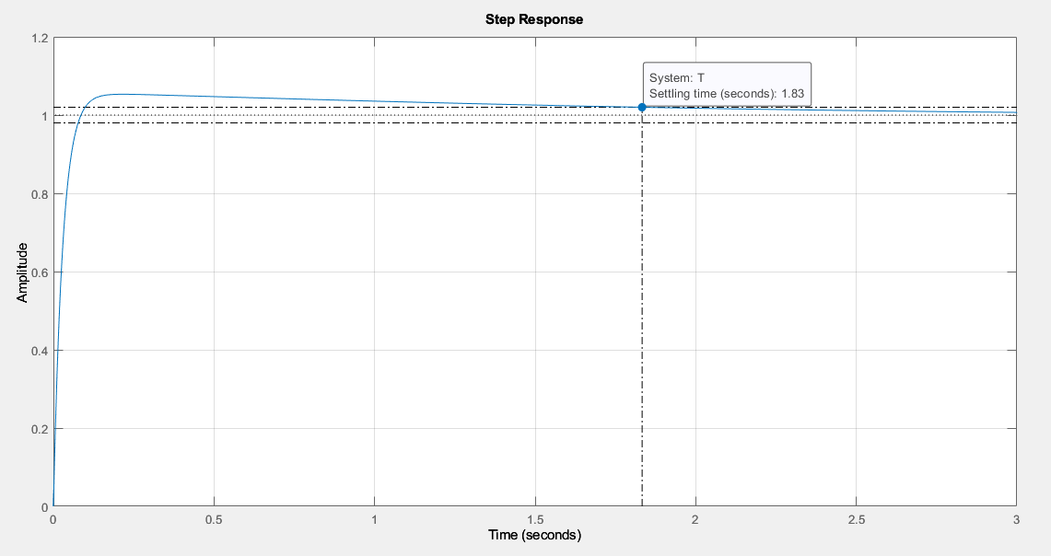
Step response
Settling time = 1.83 seconds
Peak Overshoot: 5.32%
From overshoot damping coefficient is obtained as 0.69.
The values obtained are very close to the desired design specifications.

Slide 39
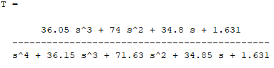
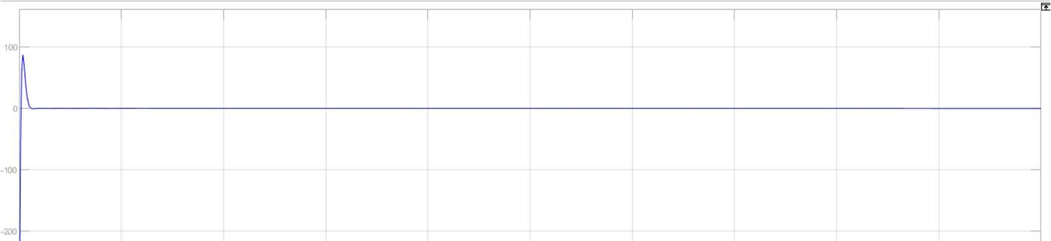
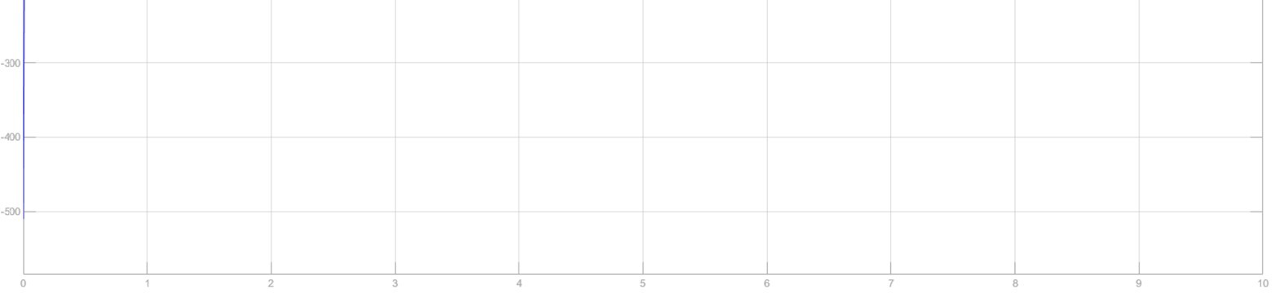
The closed loop transfer function obtained is
Controller effort

Slide 40
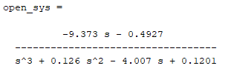
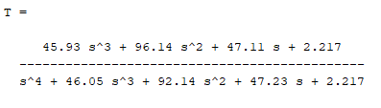
Robustness Check
Case 1:
The coefficients in the plant transfer function are changed by + 30 %.
New Open loop (or) Plant transfer function is given by,
New Closed loop transfer function is given by,

Slide 41
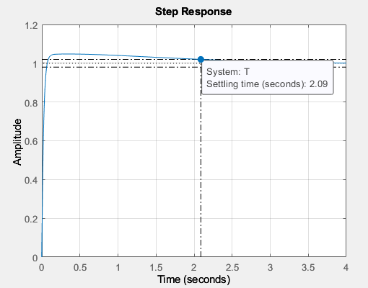
Step response
Settling time = 2.09 seconds
Peak Overshoot: 4.76%
From overshoot damping coefficient is obtained as 0.71.

Slide 42
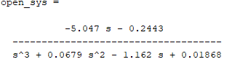
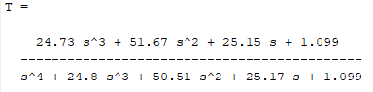
Case 2:
The coefficients in the plant transfer function are changed by - 30 %.
New Open loop (or) Plant transfer function is given by,
New Closed loop transfer function is given by,

Slide 43
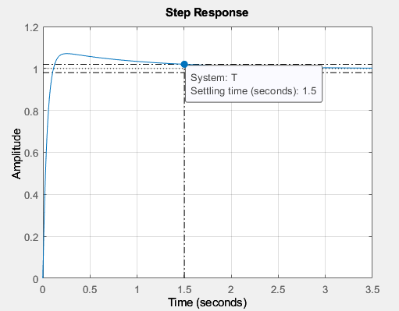
Step response
Settling time = 1.5 seconds
Peak Overshoot: 7.1%
From overshoot damping coefficient is obtained as 0.62.

Slide 44
The design specifications obtained do not stray very far off the required values.
Thus we can conclude that the controller is robust.

Slide 45
Acknowledgement
We would like to thank Dr. T. S. Chandar Sir for providing us with an opportunity to pursue this project. It gave us an insight into the applications of control systems in real life. We gained invaluable experience in designing controllers for a real life application.

Slide 46
Thank you.

